Slide 1
Course Content
What is web Application.
Multi Page web Application.
single page web Application (SPA).
Angular Introduction.
Angular JS vs Angular Framework.
Angular Framework version history.
Advantages of Angular
Angular Architecture.
TypeScript Introduction.
Advan Of Type script.
Java Script Vs Type Script.
Environment Setup
Varibles
Data Types.
Oops
class
Object
Constructor

Slide 2
Syllabus
Inheritance
Access Modifiers
Interfaces
Enumerations
Modules
Examples usng type script...

Slide 3
Commands
To create Angular file the command is -> Ng new Filename
To Create Child Module -> ng g c header

Slide 4
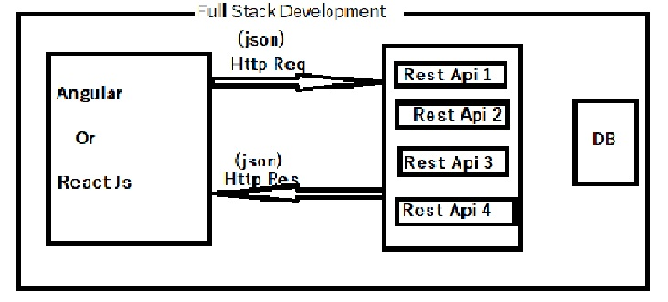
FuLL Stack Development

Slide 5
Web Application
We Have 2 types of web Applications
1.Multi page Web applications
2.Single page Web applications
Web Application: A application which is running on the server is called we application.
1.Multi page Web applications:
In multi Page Web Application All the actions are every time Reloaded like Toolbar, Side navibar and Common data will be loaded as a again and again So performance of the applications will reduced. At Every time the page handler was loaded
> In multi page applications Multiple pages are available. If client sends a req and server sent the resp as a web page.
>To Avoid that problem we are going to single page applications

Slide 6
Multipage Application Example
Client Server
Request-1
Page-1
Request-2
Page-2
Request-3
Page-3

Slide 7
Single page application
Client Server
HHHHtml
HTML Single page
Request-1
Data
Respose-1
Request-2
Json Data
Req-3
Json Data

Slide 8
Single Page Application
In SPA The data should send as a req and acpt as Json Data in SPA.
In MPA for every req new web page will be loaded at client side.Here Every time Pge will be reloaded.
In single page web Application web page will be loaded only for frt req.
From sec req onwards only content will be updated vthout reloading the entire page.EX:Gmail….
What is Full stack Development?
-> As part of full stack development we should develop backend Rest Apis and Front End user Interface.
-> To develop backend rest apis we will use "Spring Boot & Micro services“
-> To develop frontend user interface we will use below technologies .
HTML
CSS
Java Script
Bootstrap
2nd Cls….

Slide 9
Angular or React JS
-> The resource who can develop both frontend and backend logics is called as Full stack developer.
-> Full stack developers are having lot of demand in the market and companies are providing high packages for full stack developers.
What is Web Application?
-> The application which runs in the server is called as Web Application.
-> Multiple users can access web applications at a time.
Ex : Gmail, Facebook, IRCTC, Net Banking etc...
-> Now a days web applications are divided into 2 types
1.Multi Page Web applications (MPA)
2. Single Page Web applications (SPA)
-> In Multi Page Web Application for every request new web page will be loaded at the client side.
-> In Single Page web application only one web page will be available for every request just content will be updated without reloading the entire page.
Ex : Gmail, angular.io etc....

Slide 10
Intro
Advantages of SPA
-> Development will be easy
-> Maintenence will be simple
-> Good Performance Note: In single page application common content will be loaded only one time.

Slide 11
Angular Introduction
-> Angular is a client side framework –
-> Angular is used to create Web Applications
-> Angular is mainly used for Single Page Applications Development.
-> Angular supports all platforms (Desktop and Mobile)
-> Angular is free & open source
-> Angular is having cross-browser compatibility
-> Angular developed by Google.
Angular JS and Angular Framework
-> The initial version of Angular is called as Angular JS (Angular 1.x version's) which is developed by using Java Script.
-> After few days Google realized the problems with Angular JS then they started developing one new framework to develop web applications that's where Angular Framework came into Market. This Angular framework is developed by using Type Script.
-> From Version 2.0 onwards it is called as Angular Framework
-> Angular 2.0 is not enhancement for Angular 1.0 because in 2.0 version Google Developers completely re-written Angular framework by using Typescript.

Slide 12
Angular JS and Angular Framework
-> Typescript developed by Microsoft Company.
-> Angular 2+ versions are extensions for Angular 2.0 version
-> Angular 1.x versions are called as Angular JS
-> Angular 2.0 and later versions are called as Angular Framework versions
-> The current version of Angular is 11(Updated Nov-2020)
Angular Architecture:-
1) Components
2) Meta Data
3) Services
4) Templates
5) Directives
6) Pipes.

Slide 13
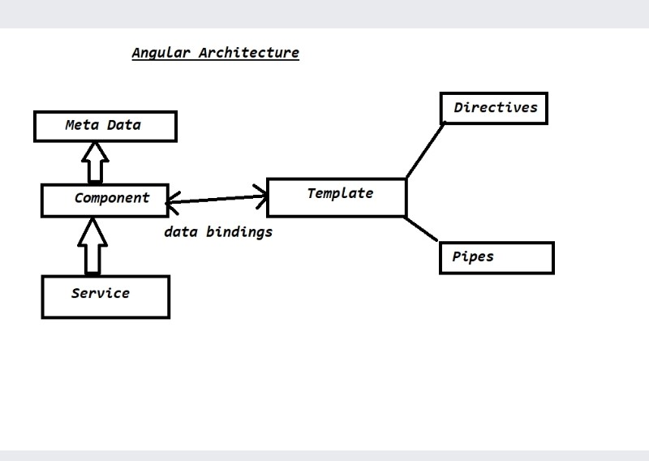
Architecture Of Angular

